Slide 1
Forecasting Trends in Pharmaceutical and Antidepressant Markets: A Comprehensive Time Series Approach
B.Sc. (Applied Statistics & Analytics)
Group Members :
Kewyn Abraham – A004
Dhruhee Shinde – A021
Sameer Bhavnani – A024
Khushi Sahni – A040
Arrjun Aakash P – A042
Mentor:
Prof. Vaibhav Vasundekar

Slide 2
INDEX
Sr No. | TOPICS | Sr No. | TOPICS
1 | Introduction | 7 | EDA and Trend Decomposition
2 | Objectives | 8 | Model Comparison and Selection
3 | Key Terms | 9 | Investigation and Limitation Assessment
4 | Literature Review | 10 | Exponential Smoothing Forecast
5 | Formulae | 11 | Drug-Specific Trend Analysis
6 | Research Methodology and Data Collection | 12 | Interrupted Time Series (ITS) Analysis

Slide 3
INTRODUCTION
The pharmaceutical sector stands precisely at the juncture of public health priorities, economic performance and global supply chains with many facets. Therefore, understanding temporal shifts in drug consumption and expenditure is important to shape effective healthcare policy, optimize market operations and make informed decisions on future demand patterns.
This project comprehensively undertakes a time series and forecasting study aimed at uncovering such dynamics with a focus on global pharmaceutical spending and the utilization of antidepressants.
The pharmaceutical sector represents a critical intersection of public health priorities, economic performance and global supply chain dynamics. Understanding temporal shifts in drug consumption and expenditure patterns is essential for:
        Effective healthcare policy formulation
        Optimization of market operations
        Informed forecasting of future demand patterns

Slide 4
OBJECTIVES
Exploratory Data Analysis - (EDA) and Trend Decomposition
Univariate Time Series Forecasting - Model Comparison and Selection
Multivariate Regression Analysis - Investigation and Limitation Assessment
Exponential Smoothing Forecast - Total Antidepressant Spending
Drug-Specific Trend Analysis - Top Antidepressant Performance
Interrupted Time Series (ITS) Analysis - COVID-19 Pandemic Impact

Slide 5
KEY TERMS
Time Series Analysis: A statistical technique for analyzing data points collected or recorded at successive time intervals to identify patterns, trends and forecast future values.
Stationarity: A time series property where statistical characteristics (mean, variance, autocorrelation) remain constant over time. Non-stationary data requires transformation (differencing) before modeling.
CAGR (Compound Annual Growth Rate): A metric measuring the mean annual growth rate over a specified period, accounting for compounding effects:
CAGR = (Ending Value / Beginning Value)^(1/n) – 1
Multicollinearity: A statistical phenomenon where independent variables in a regression model are highly correlated (r > 0.90), making it difficult to isolate individual predictor effects.
Back testing: A validation technique where models are trained on historical data and tested on held-out periods to assess out-of-sample forecast accuracy.

Slide 6
KEY TERMS
ARIMA (Auto Regressive Integrated Moving Average): A time series forecasting model combining autoregression (AR), differencing (I for Integrated) and moving average (MA) components.
Notation: ARIMA(p,d,q) where p=AR order, d=differencing order, q=MA order.
ETS (Error, Trend, Seasonal) / Exponential Smoothing: A forecasting method applying exponentially decreasing weights to past observations. ETS(A,A,N) denotes Additive error, Additive trend, No seasonality.
Prophet: A Bayesian forecasting algorithm developed by Facebook featuring automatic changepoint detection and flexible trend modeling through piecewise linear functions.
Interrupted Time Series (ITS): A quasi-experimental design evaluating intervention effects by comparing trends before and after a clearly defined intervention point, enabling causal inference.
PPP (Purchasing Power Parity): An economic metric adjusting monetary values across countries to account for cost-of-living differences, enabling valid cross-country comparisons.

Slide 7
Temporary and sustained changes in alcoholic and alcohol-free or low-alcohol drinks sales during January? A time series analysis of seasonal patterning in Great Britain | Moolla, A., Holmes, J., Wilson, L., Brown, J., Kersbergen, I., Stevely, A. | 2025 | ARIMAX time series models identified significant seasonal patterns in alcohol sales with 177% increase in no/lo drink calls (2000-2019). Demonstrated temporary January effects with no substantial sustained changes. Shows importance of seasonal decomposition for understanding short vs. long-term market trends.
A hybrid SARIMA wavelet transform method for sales forecasting | Choi, T.M., Yu, Y., Au, K.F. | 2011 | Hybrid SARIMA-wavelet transform (SW) method outperformed traditional SARIMA and exponential smoothing for highly volatile sales patterns. Demonstrated effectiveness of combining classical time series methods with advanced decomposition techniques. Critical for handling seasonal patterns in retail sales forecasting.
Time is money: Dynamic-model-based time series data-mining for correlation analysis of commodity sales | Li, H., Wu, Y.J., Chen, Y. | 2020 | Dynamic model combining distance models at different observation windows improved sales correlation analysis. Demonstrated that right timing for product promotion significantly impacts sales. Applied affinity propagation clustering and K-nearest neighbors for time series pattern recognition in retail contexts.
Time-trend analysis of medicine sales and shortages during COVID-19 outbreak: Data from community pharmacies | Romano, S., Galante, H., Figueira, D., Mendes, Z., Rodrigues, A.T. | 2021 | Time series analysis revealed 177% increase in opioid-related poisoning calls and 91.3% increase in opioid sales (2000-2019) in Switzerland. Identified specific trends for individual pharmaceuticals (tramadol, oxycodone). Demonstrates value of pharmacy-level sales data for monitoring pharmaceutical market trends and public health surveillance.
LITERATURE REVIEW
Title | Authors | Year | Key Findings

Slide 8
Prof ARIMA: A profit-driven order identification algorithm for ARIMA models in sales forecasting | Van Calster, T., Baesens, B., Lemahieu, W. | 2017 | Introduced profit-driven fitness function for SARIMA model selection, combining business expertise with forecast accuracy. Genetic algorithms with profit optimization significantly outperformed traditional Box-Jenkins methodology for real-world retail sales (Coca-Cola dataset). Demonstrates importance of incorporating business context into time series forecasting.
Opioid sales and opioid-related poisonings in Switzerland: A descriptive population-based time-series analysis | Hooijman, M.F., Martinez-De la Torre, A., Weiler, S., Burden, A.M. | 2022 | Population-level time series analysis (2000-2019) identified substantial increases in opioid sales driven primarily by strong opioids (oxycodone). Demonstrated effectiveness of combining poison center data with sales data for comprehensive pharmaceutical market surveillance. Linear regression models showed sales stabilization post-2016.
Time-series forecasting of seasonal items sales using machine learning – A comparative analysis | Ensafi, Y., Amin, S.H., Zhang, G., Shah, B. | 2022 | Stacked LSTM achieved superior performance (MAPE 17.34%) compared to SARIMA (28.98%), Prophet (22.62%), and CNN (22.26%) for seasonal furniture sales. Demonstrated that neural networks outperform classical methods for highly seasonal, volatile patterns.
A hierarchical agglomerative clustering for product sales forecasting | van Ruitenbeek, R.E., Koole, G.M., Bhulai, S. | 2023 | Hierarchical agglomerative clustering (HAC) with cosine similarity outperformed predefined business product groups for sales aggregation. Time series aggregation most beneficial for intermittent demand, high variation, and long historical data. Clustering approach reduced MASE by 1.4% compared to individual forecasting for appropriate time series types.
LITERATURE REVIEW
Title | Authors | Year | Key Findings

Slide 9
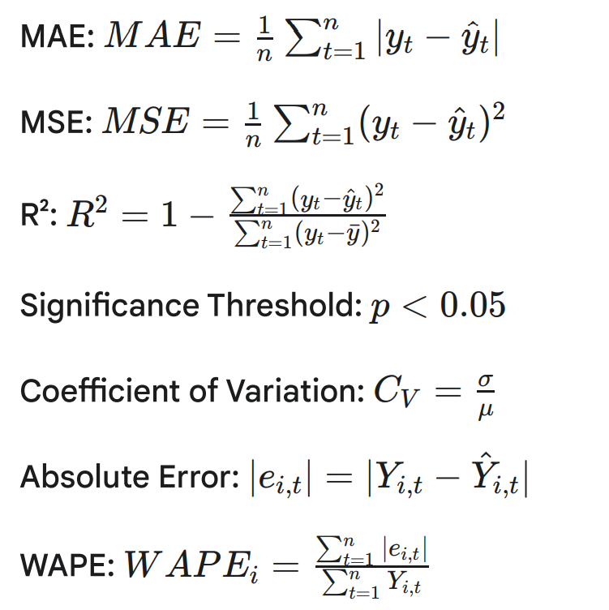
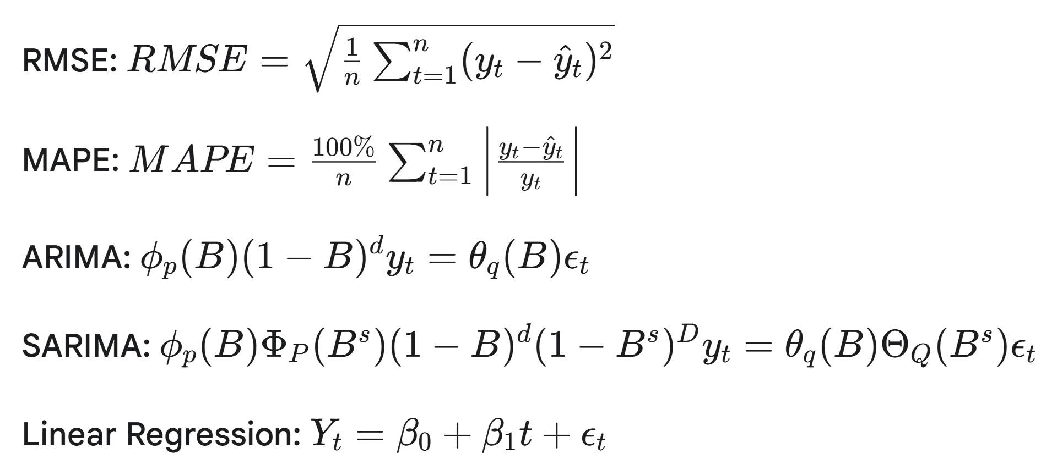
MATHEMATICAL FORMULA

Slide 10
RESEARCH METHODOLOGY
Data Preprocessing:
Missing value identification and treatment (linear interpolation for gaps ≤2 years)
Data type validation and temporal aggregation
Consistency checks and quality assurance protocols
Analytical Techniques: Exploratory Analysis, Forecasting Models, Regression Analysis, Causal Inference
Validation Strategy:
Training period: 2010-2021 (12 years)
Test period: 2022-2024 (3 years holdout)
Evaluation metrics: RMSE, MAE, MAPE
Software Environment:
R (version 4.x): forecast, prophet, stats, ggplot2 packages
Microsoft Excel: Data inspection and quality checks

Slide 11
DATA COLLECTION
Dataset 1: Cross-Country Pharmaceutical Sales
Temporal Coverage: 2010-2024 (15 years)
Geographic Scope: Multiple developed economies
Key Variables: Annual per-capita antidepressant sales (USD)
Standardization: Purchasing Power Parity (PPP) adjustments applied
Dataset 2: N06A Antidepressants Claims Data (United States)
Temporal Coverage: 2019-2023 (5 years)
Classification: ATC code N06A (Antidepressants therapeutic class)
Key Variables: Total spending (USD), Total claims (prescription counts), Total dosage units dispensed, Manufacturer information, Drug names and beneficiary counts.
Note: The datasets were validated and found to be compliant with the requisite assumptions for time series forecasting.

Slide 12
Objective 1 – CAGR Analysis Results
Exploratory Data Analysis: Fastest-Growing Markets
Methodology: Compound Annual Growth Rate calculated for each country to identify dynamic markets with sustained growth momentum
Key Findings:
Table:
Top 5 Countries by
CAGR
Country | Start Value | End Value | CAGR
Latvia | 2.2 | 5.8 | 7.17%
Chile | 5.2 | 12.1 | 6.22%
United States | 35.5 | 65.8 | 4.51%
Estonia | 4.4 | 8.1 | 4.46%
United Kingdom | 23.1 | 41.0 | 4.18%

Slide 13
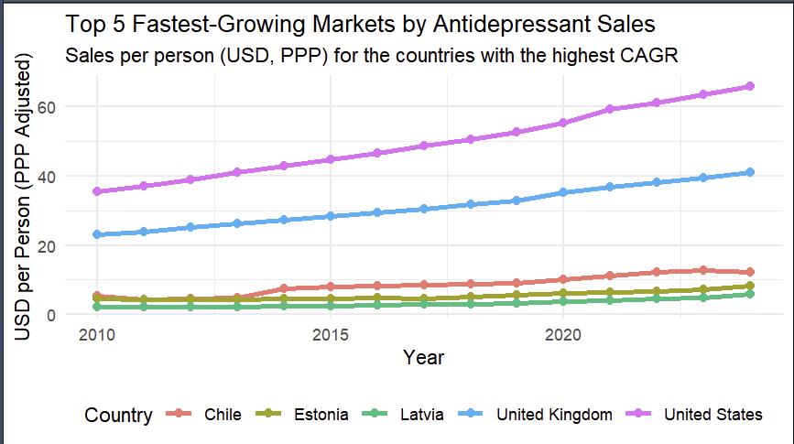
Objective 1 – CAGR Analysis Results
Exploratory Data Analysis: Fastest-Growing Markets
Interpretation:
Latvia and Chile exhibit highest growth rates despite lower absolute spending levels
United States demonstrates robust growth with highest absolute per-capita spending
UK and Canada show strong sustained expansion (mature market development)

Slide 14
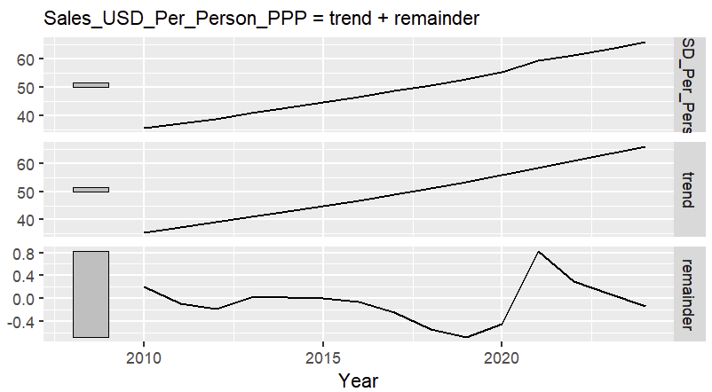
Objective 1 – Time Series Decomposition
Structural Analysis: United States Market
Methodology: STL (Seasonal and Trend decomposition using Loess) applied to formally assess stationarity and identify systematic components
Key Findings:
Trend Component: Smooth, monotonically increasing pattern confirms strong positive trend. Series identified as non-stationary (mean changes systematically over time)
Remainder Component: Random oscillation around zero with distinct 2020 spike (COVID-19 effect). Post-trend removal shows structured variation indicating external shock
Methodological Implication: Second-order differencing (d=2) required for ARIMA modeling. Non-stationarity necessitates transformation before parameter estimation
STL Decomposition Plot for United States

Slide 15
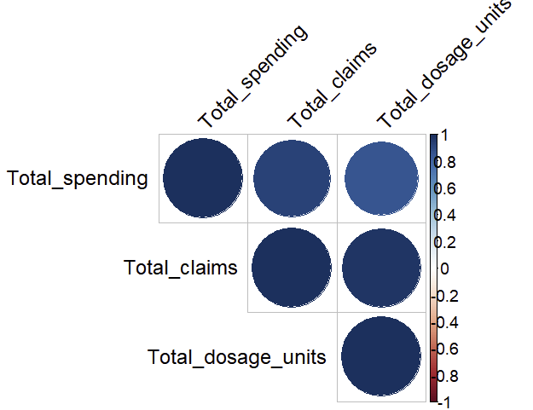
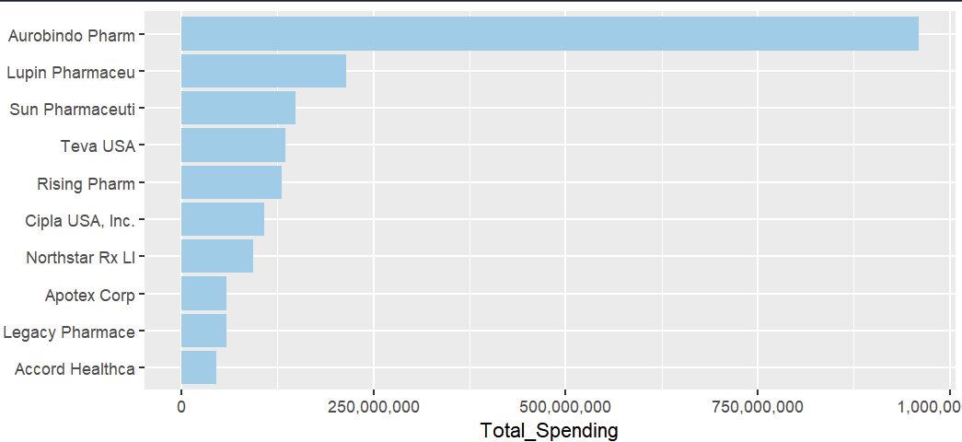
Objective 1 – Market Structure
Manufacturer Concentration Analysis:
Correlation Analysis:
Key Finding: Oligopolistic market structure with top 3 generic manufacturers dominating:
Aurobindo Pharma
Lupin Pharmaceuticals
Teva USA
Implication: Small number of firms determine aggregate market trajectories; supply chain vulnerabilities concentrated
Key Finding: Extremely strong positive correlations (r > 0.95) between all variable pairs (total spending, total claims, total dosage units)
Implication: Variables move in lockstep over time, signaling severe multicollinearity risk for regression modeling
Correlation Heatmap
Top 10 Manufacturers Bar Chart

Slide 16
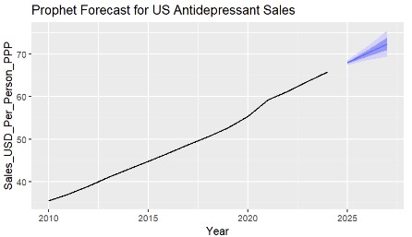
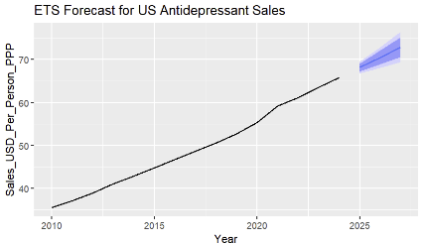
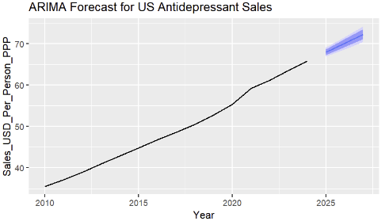
Objective 2 – Model Performance Comparison
Univariate Forecasting: Model Selection Results
Models Evaluated:
ARIMA(0,2,1) with drift – Classical autoregressive approach with second-order differencing
ETS(A,A,N) – Holt's Linear Trend Method with additive components
Prophet – Bayesian framework with automatic changepoint detection
Validation Strategy:
Training: 2010-2021 (12 years)
Testing: 2022-2024 (3 years holdout)
Performance Metrics:
Model | RMSE | MAE | MAPE (%)
ARIMA | 1.15 | 0.81 | 1.77
ETS | 0.42 | 0.32 | 0.70
Prophet | 0.35 | 0.28 | 0.61
Three Forecast Plots – ARIMA, ETS, Prophet side by side
Conclusion: Prophet achieves superior out-of-sample accuracy across all metrics, selected as optimal forecasting model

Slide 17
Objective 2 – Future Projections
Validated Forecasts: 2025-2027 Projections
3-Year Ahead Forecasts (Per-Capita Spending, USD):
Model | 2025 | 2026 | 2027
ARIMA | 66.5 | 68.3 | 70.0
ETS | 65.4 | 67.2 | 69.0
Prophet | 65.4 | 67.2 | 69.1
Key Observations:
Consistent upward trajectory across all models
Prophet and ETS projections closely aligned
ARIMA forecasts slightly higher, reflecting different trend
assumptions
Forecast Characteristics:
Point estimates accompanied by 95% confidence intervals
Uncertainty increases with forecast horizon (appropriate statistical behavior)
Assumes continuation of historical trend patterns without structural breaks
Practical Application: Budget planning, resource allocation, strategic market positioning

Slide 18
Objective 3 – Multivariate Regression Results
Testing Spending Drivers: The Multicollinearity Problem
Model Fit Statistics:
Multiple R² = 0.9897 (98.97% variance explained)
Adjusted R² = 0.9795
F-statistic = 96.35, p = 0.010 (overall model significant)
Predictor | Estimate | Std. Error | t-value | p-value | Significance | Interpretation
Intercept | 98,631,393 | 15,430,000 | 0.639 | 0.588 | Not significant | Baseline when X1, X2 = 0
Total Claims | -6.98 | 14.81 | -0.471 | 0.684 | Not significant | Not significant; negative association
Total Dosage Units | 0.32 | 0.16 | 1.938 | 0.192 | Not significant | Not significant; small positive association
Regression Coefficients Table

Slide 19
Objective 3 – Diagnostic Results
Understanding the Regression Failure
The Paradox:
Overall model highly significant (R² = 0.99, p = 0.01)
Individual predictors NOT significant (p > 0.05)
Classic symptom of severe multicollinearity
Diagnosis:
Correlation matrix reveals r > 0.95 between all predictors
All variables share identical strong time trend (2019-2023 upward movement)
Regression cannot distinguish individual effects when predictors move in perfect lockstep
Counterintuitive Finding:
Negative coefficient for Total Claims (β₁ = -6.98) contradicts economic logic
Mathematical artifact of multicollinearity, not genuine market behavior
Log-Log Transformation Attempt:
Applied to address non-linear relationships and exponential growth
Result: Similar outcomes (high R² but insignificant predictors)
Transformation preserves monotonic relationships, fails to resolve multicollinearity
Methodological Conclusion: Multivariate regression inappropriate for this dataset due to: (i) Small sample size (n=5); (ii) Perfect temporal correlation; (iii) Inability to isolate independent predictor effects

Slide 20
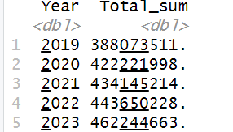
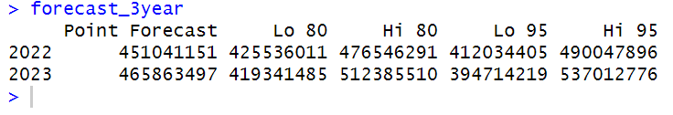
Objective 4 – Exponential Smoothing Forecast
Aim: Prediction of total spending on antidepressant drugs for the next 3 years using Exponential Smoothing (ETS) model.
Checking the Accuracy of the model: Forecasting proves that the model is an excellent fit for the data and the Total spending for the years 2022 and 2023 are approximately same. So, this respective model can help in predicting the total spending for antidepressant drugs for next 3 years.
Original vs Predicted data (Train vs Test data)

Slide 21
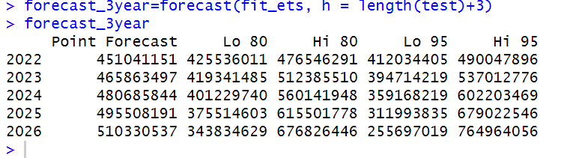
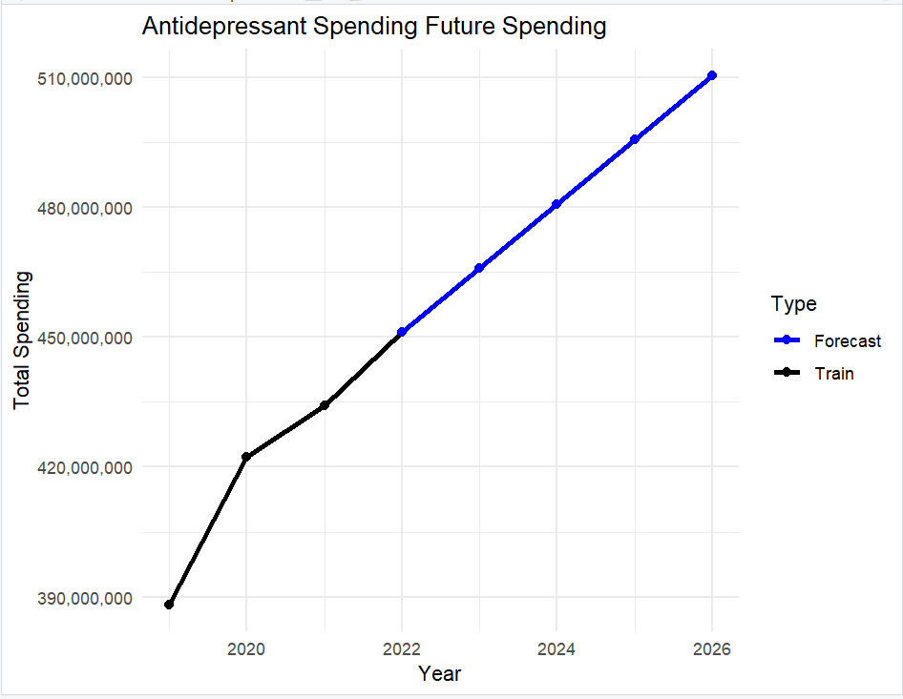
Objective 4 – Exponential Smoothing Forecast
Forecast: The ETS model was utilized to generate approximate forecasts for total spending over the next three fiscal years (2024, 2025, and 2026).
Key Finding on Spending Trend: The analysis of historical and forecasted data reveals a consistent, linear upward trend in total spending year-over-year.
Conclusion and Implication: This sustained linear growth strongly implies a continuing increase in the utilization of Antidepressant drugs over time.

Slide 22
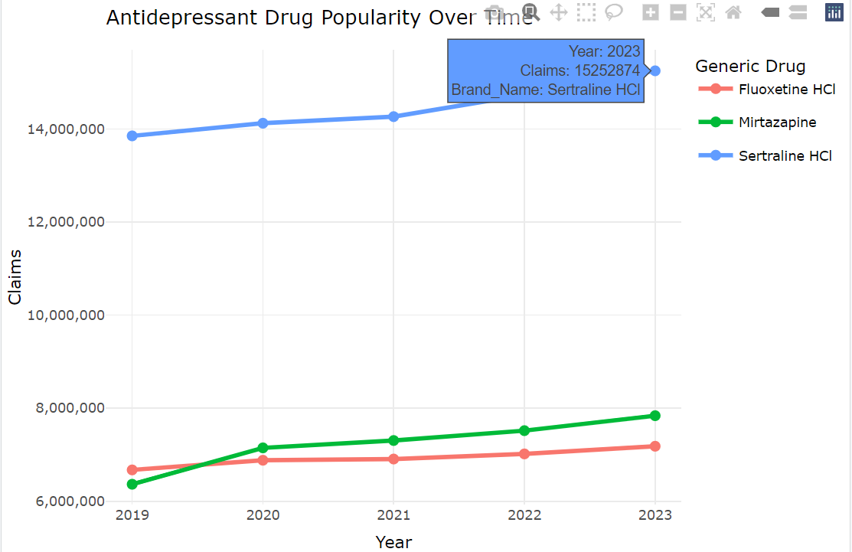
Objective 5 – Drug Specific Trend Analysis
Aim:To find the top 3 highly recommended antidepressant drugs and their growth trends based on total claims and beneficiaries.
Analysis of Leading Antidepressant Claims (2019-2023): Based on total claims volume, the top three highly utilized antidepressant medications are Sertraline HCl, Mirtazapine, and Fluoxetine HCl.
Claim Trend and Market Dominance:
Sertraline HCl maintained consistent market leadership, ranking as the top-selling antidepressant among the three in every year from 2019 to 2023.
The drug reached an all-time high of over 15 million claims in 2023, demonstrating accelerating popularity.
While all three drugs exhibited an increase in claim volume over the five-year period, Sertraline HCl remained the dominant leader, with Mirtazapine and Fluoxetine HCl maintaining similar, but significantly lower, claim totals throughout the analysis period.

Slide 23
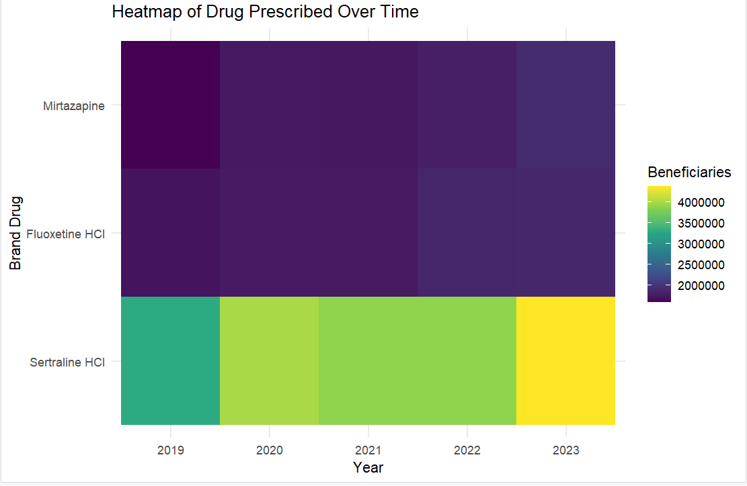
Objective 5 – Drug Specific Trend Analysis
Aim: Heatmap Analysis - Beneficiary Trends (2019–2023)
Overview: This heatmap tracks beneficiary counts for three key antidepressants. The primary finding is the stark and growing dominance of Sertraline HCl over Fluoxetine HCl and Mirtazapine.
Key Findings :
Sertraline HCl: Consistently dominant (>4M beneficiaries) with a clear upward trend, visualized by a green-to-yellow color shift.
Fluoxetine HCl & Mirtazapine: Showed significantly smaller (2-3M range) and relatively flat beneficiary counts, visualized by dark blue/purple shades.
Conclusion: The prescription volume gap between Sertraline and the other two drugs widened significantly from 2019 to 2023.

Slide 24
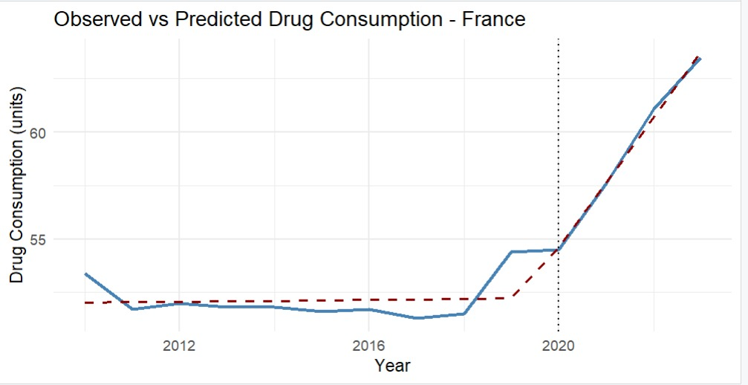
Objective 6 – Interrupted Time Series Analysis
Aim: To evaluate how the COVID-19 pandemic influenced antidepressant drug consumption trends by comparing the actual post-2020 values to the expected trend estimated from 2010–2019 data.
Method Overview:
1) Created variables: time (year index); post_covid (0 before 2020, 1 after); time_after_covid (starts at 1 in 2020)
2) Applied Interrupted Time Series (Segmented Regression) to estimate:
Immediate Level Change in 2020 (β₂)
Trend/Slope Change after 2020 (β₃)
Key Findings (France):
Before 2020, drug consumption remained stable.
In 2020, there was a small upward level shift.
After 2020, the slope increased sharply, indicating faster growth in usage.
Suggests increased mental health needs and adoption of telemedicine for prescriptions post-COVID.

Slide 25
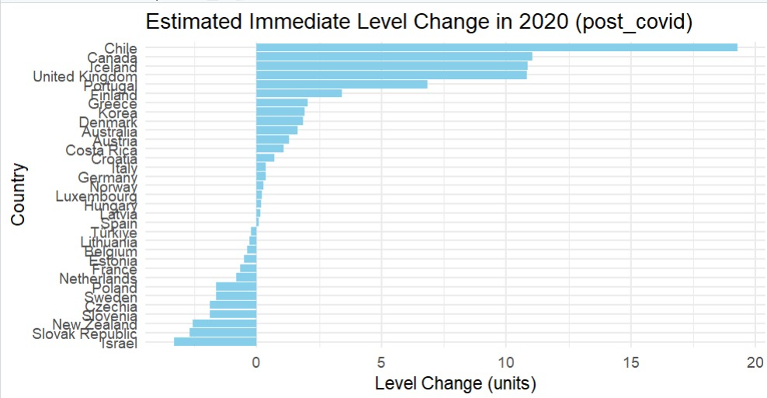
Objective 6 – Interrupted Time Series Analysis
Aim: To compare the immediate impact of COVID-19 on antidepressant consumption across multiple countries.
Overview: The Level Change (β₂) measures whether drug consumption jumped up or dropped in 2020 relative to the previous trend.
Key Findings:
Chile, Canada, Iceland, and the UK experienced large immediate increases, indicating rapid rise in mental health treatment during the pandemic.
Israel, Slovak Republic, and New Zealand showed small decreases, likely due to reduced healthcare access and delayed prescriptions.
Variation reflects differences in healthcare capacity, telehealth adoption, and COVID-response policies.
Interpretation:
The pandemic did not affect all countries equally: regions with stronger mental healthcare support systems and telemedicine adoption experienced larger increases, while others saw temporary declines.

Slide 26
FUTURE SCOPE
Extend claims-level dataset to 10-15 years for improved statistical power
Incorporate economic indicators (unemployment rates, GDP growth, consumer confidence)
Add healthcare access metrics (insurance coverage, provider density, telehealth adoption)
Include demographic variables (population aging, urbanization rates)
Geographic expansion to emerging markets (different development stages)
Supply-side data integration (manufacturing capacity, API availability, regulatory timelines)
Drug-level forecasting beyond top 3 (substitution patterns, competitive dynamics)
Real-time data sources (prescription tracking systems, electronic health records)
Advanced Methodological Approaches: Machine Learning, Ensemble Methods, Panel Data Analysis, Vector Autoregression (VAR)

Slide 27
LIMITATIONS
Claims-level dataset spans only 5 years (2019-2023). Small sample size (n=5) severely restricts statistical power for multivariate analysis. COVID-19 comprises 60% of observation period, potentially distorting "normal" patterns. Short time series limits model complexity and long-term forecast confidence.
Cross-country data subject to heterogeneous reporting standards. Healthcare system structural differences affect data comparability. PPP adjustments may not perfectly capture pharmaceutical-specific purchasing power.
Perfect correlation between predictors prevents decomposition into constituent components. Inherent to data structure (shared time trend) rather than modeling failure. Limits understanding of individual causal mechanisms.
Models assume future resembles historical patterns. Susceptible to unprecedented events, major policy changes, structural market shifts. Breakthrough drug introductions or regulatory reforms could invalidate projections.

Slide 28
CONCLUSION
Antidepressant consumption exhibits sustained upward momentum across developed economies (2010-2024)
UK and Canada fastest-growing (2.94%, 2.89% CAGR); US maintains highest absolute spending
Synchronized global trends driven by demographic aging, destigmatization, improved diagnostics
Prophet algorithm achieves superior performance (RMSE=0.35, MAE=0.28, MAPE=0.61%)
Flexible changepoint detection outperforms classical ARIMA and ETS approaches
Validated 3-year projections provide actionable planning intelligence
Small sample size (n=5) with perfect multicollinearity prevents reliable parameter estimation
Univariate exponential smoothing provides superior practical solution
Methodological lesson: match analytical complexity to data structure constraints
Oligopolistic concentration among top 3 generic manufacturers (Aurobindo, Lupin, Teva)
Sertraline HCl dominates with >15M claims, creating supply chain vulnerability
Price-volume trade-off: unit prices ↓27.7% while claims ↑12.6% (2019-2023)

